Slide 1

Cyclistic Bike-Share Analysis
Created by
Surbhi Verma

Slide 2



Cyclistic Bike-Share introduction
Cyclistic is a leading bike-share company in Chicago, offering a convenient and sustainable transportation option for residents and visitors.
The bikes can be unlocked from one station and returned to any other station in the system anytime.
Challenge
Aims to boost annual memberships to solidify their position as Chicago's go-to bike-sharing solution.
Purpose
Leverage data-driven insights to inform marketing strategies for converting Casual riders into loyal Annual members.
Strengthening Cyclistic's market position and drive sustainable growth.
Casual Riders
Purchases a single ride or a full day pass.
Annual Members
Purchases annual membership for an year.

Slide 3

Maximizing annual memberships is vital for Cyclistic's:
Steady Revenue
Customer Loyalty
Cost Efficiency
Valuable Data Insights
Competitive Edge

Slide 4

Visualization Impact
Data Communication
Clarity & Understanding
Compelling visual representations of bike-share data aid in effective communication of findings, enabling stakeholders to interpret and grasp complex data trends and insights with ease.
Effective visualization enhances the clarity of bike-share analysis, making it easier to recognize patterns, outliers, and correlations within the data, ultimately improving decision-making and strategic planning.

Slide 5
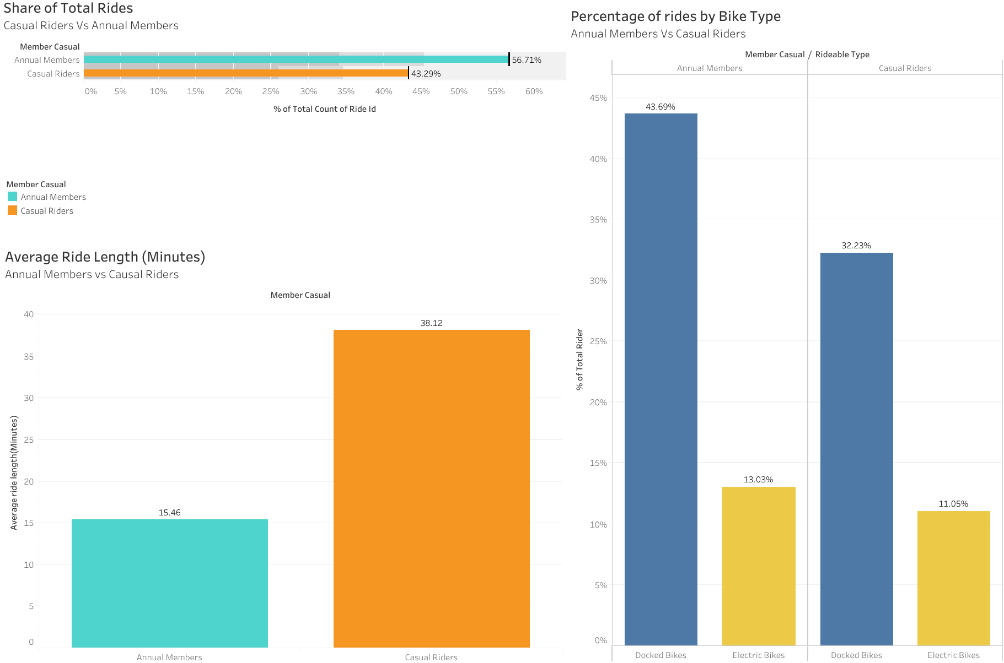

Slide 6
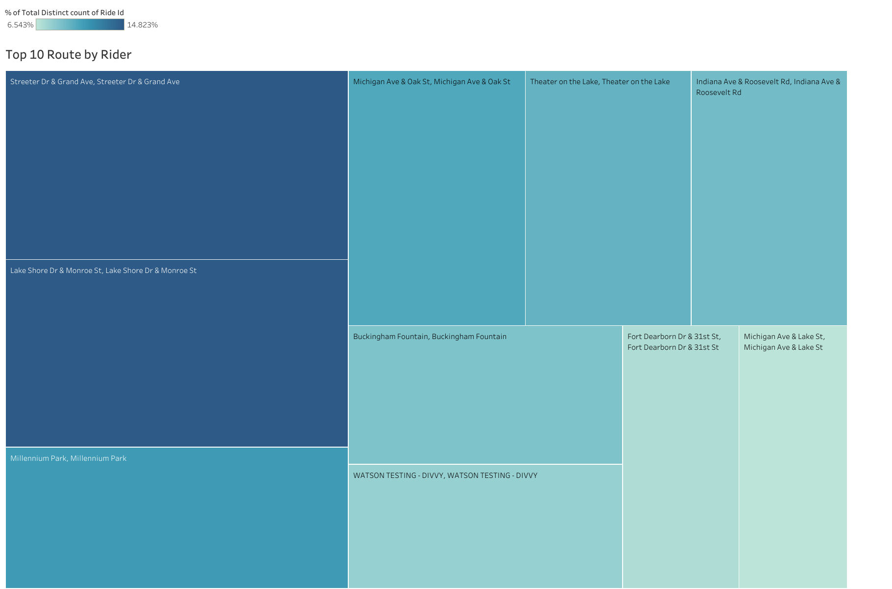

Slide 7
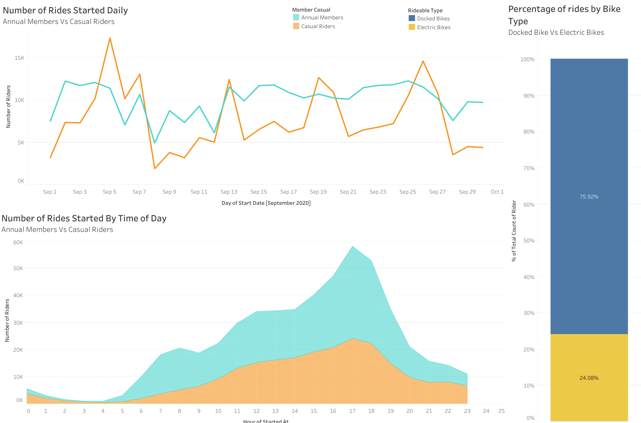

Slide 8
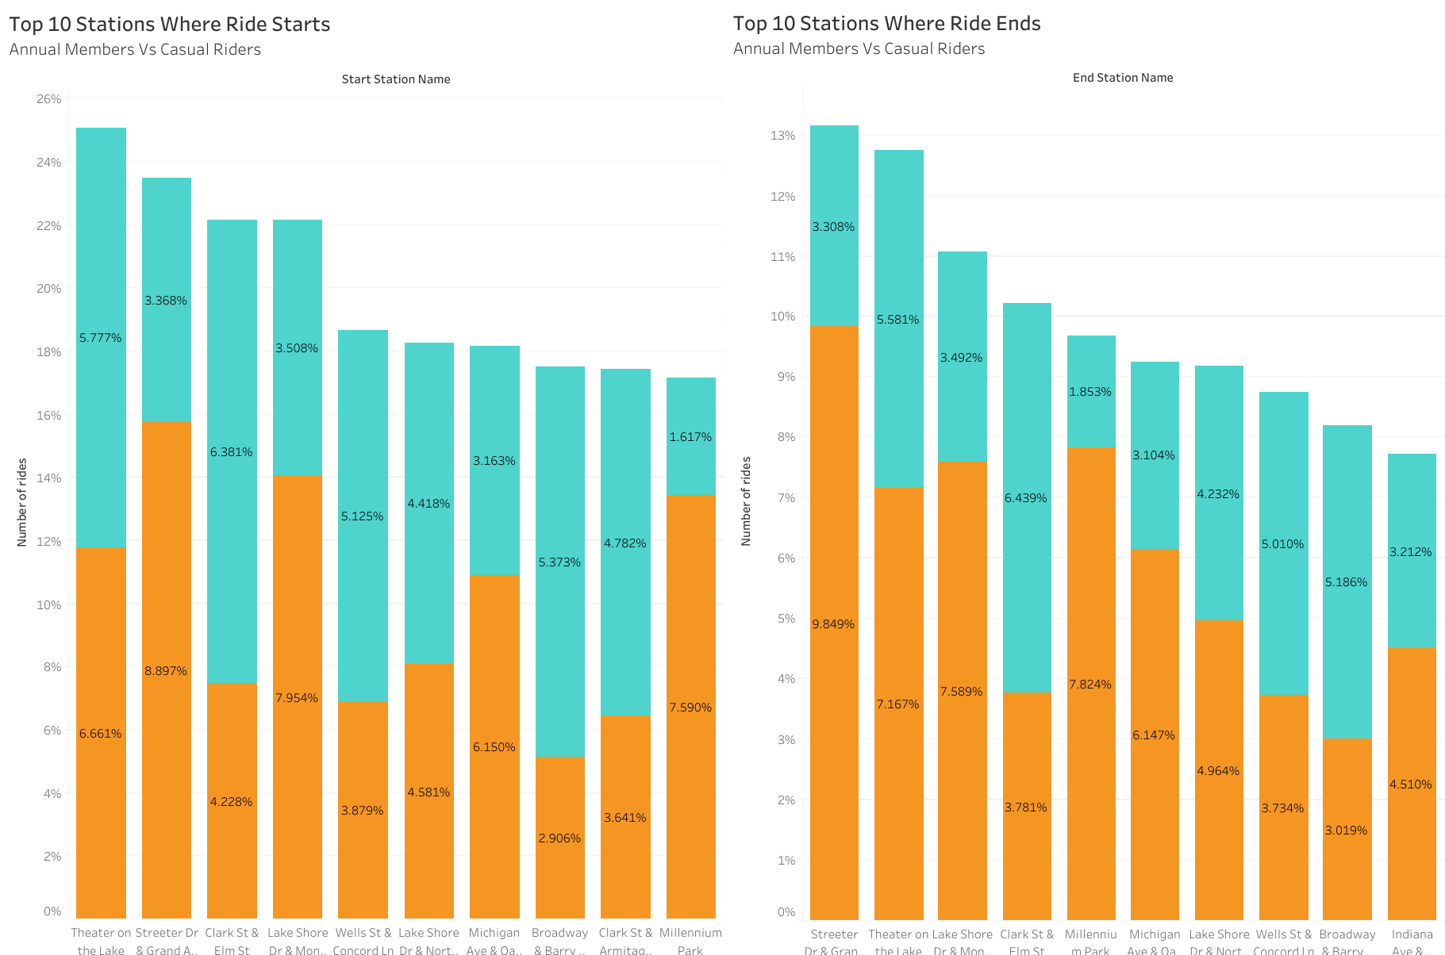

Slide 9
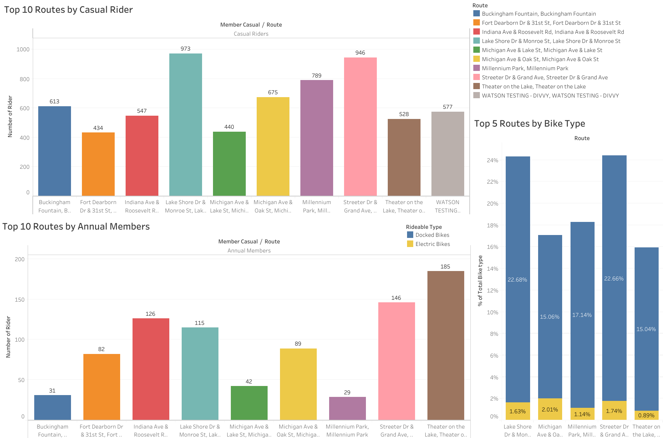

Slide 10
Key Findings
Insight | Description
Peak Usage Times | 7-8 am and 4-7pm(Daily) 1st & Last week of Month
Popular Routes | Lakefront Trail, Millennium Park
Subscriber Behavior | Approx 57% of riders are subscribers
Most Bike type being used | Docked Bike
Trip Duration | Average trip duration is 50 mins (Annual members-13.43, Casual Rider-38.12)

Slide 11
Data-driven Insights
User Behavior Trends
Marketing Strategies
Service Expansion
Data analysis has revealed overarching patterns in user behavior, such as commuting habits, preferred bike stations, and factors influencing rider satisfaction, providing valuable insights for service optimization.
By harnessing data-driven insights, Cyclistic can tailor marketing strategies to target specific user segments, personalize promotions, and enhance user engagement, ultimately driving business growth and retention.
The analysis has identified potential areas for service expansion, guiding decisions on station placement, operational improvements, and resource allocation to meet growing demand in key locations.

Slide 12
Recommendations & Suggestions
Incentives for Conversion
Enhance User Experience
Targeted Marketing Campaigns
Offer discounted rates, exclusive member benefits, or referral rewards to encourage casual riders to transition to annual memberships.
Improve the Cyclistic app and website for easy navigation, personalized recommendations, and seamless membership sign-up processes.
Develop data-driven marketing campaigns tailored to rider behavior and preferences to attract more annual memberships.
Flexible Membership and Pricing Models
Promote Benefits of Biking
Optimize Operations and Expand Network
Introduce flexible membership options like pay-as-you-go or monthly subscriptions, and explore new service offerings with added privileges for higher-priced plans.
Use social media to highlight the benefits of bikeshare and electric bikes, and emphasize the health and wellness benefits of cycling.
Optimize bike distribution by reallocating bikes to high-demand areas and expand the network of bike stations, particularly in high-traffic and underserved neighborhoods.

Slide 13

Conclusion
The analysis of Cyclistic's rider data has provided valuable insights that can inform strategic decisions aimed at increasing annual memberships.
Implementing incentives, enhancing the user experience, and developing targeted marketing campaigns can drive growth and ensure long-term success.
We understand the differences in how casual riders and members use Cyclistic bikes, but the reasons behind these differences remain inconclusive.
A more granular examination is necessary to devise an effective conversion strategy.
Moving forward without this critical information could be risky.

Slide 14

Thank You
https://public.tableau.com/views/Book1_17184618605120/CyclisticRideAnalysis?:language=en-US&publish=yes&:sid=&:display_count=n&:origin=viz_share_link

